Slide 1





Enterprise E-Commerce
Intelligence & Predictive Analytics
DIGITAL EGYPT PIONEERS INITIATIVE • DATA ANALYSIS TRACK
Turning 13,000+ raw transactions into a single source of truth — and a 7-page executive intelligence system powered by Power BI, Python, and machine learning.
PROJECT TEAM
Duaa Abd-Elati • Hazem Mahmoud • Mai Gamal • Maya Mohamed Osama Hussein • Ahmed Ezzat
Supervisor: Eng. Mohamed Alemam
Mentor: Eng. Mahmoud
11/07/2026
Notes:
1.7.2013
1
‹#›

Slide 2









WHAT WE'LL COVER
Agenda
01
02
03
Project Overview
Technical Architecture
Data Engineering
Concept, data source & the four analytical pillars
Tools, Medallion layers & the Gold star schema
Cleaning, feature engineering & KPI derivation
04
05
06
Machine Learning
Dashboard Suite
The 7 Dashboards
Isolation Forest anomaly detection engine
Design philosophy behind the 7-page Power BI system
A walkthrough of every command center, page by page
DEPI | Enterprise E-Commerce Intelligence
02
11/07/2026
02
Notes:
1.7.2013
2
‹#›

Slide 3




CHAPTER 1 · PROJECT OVERVIEW
From Raw Transactions to Executive Strategy
Four Analytical Pillars
The rapid growth of global digital commerce generates massive volumes of transactional data, yet organizations struggle to turn granular operations into executive decisions. This project implements an end-to-end Modern Data Stack, built under the Digital Egypt Pioneers Initiative (DEPI), to close that gap.
Product Intelligence & Portfolio Optimization
Machine Learning & Predictive Analytics
Advertising (PPC) & Halo Effect Analysis
The Single Source of Truth
Raw e-commerce data is transformed into a centralized Data Warehouse using the Medallion Architecture , establishing an SSOT that powers demand forecasting and automatically flags margin-eroding “Bleeding SKUs.”
Financial Risk & Operational Efficiency
DEPI | Enterprise E-Commerce Intelligence
03
11/07/2026
03
Notes:
1.7.2013
3
‹#›

Slide 4





CHAPTER 1 · DATA FOUNDATION
The Dataset Behind the Story
13,000+
37
5
4
Real-world corporate
transaction records
Granular attributes per
transaction
European marketplaces
UK · DE · FR · IT · ES
Processing tools
SQL · Python · Excel · Power BI
Key Metrics Tracked
SKU Identifiers
PPC Ad Spend
FBA Fees
COGS
Promotions
Refunds
Sessions
Clicks
Page Views
Processing Stack: Relational SQL Database → Python (Pandas / Scikit-Learn / Prophet) → Excel → Power BI. Source files delivered as Excel (.xlsx), full downloaded record set used end-to-end.
DEPI | Enterprise E-Commerce Intelligence
04
11/07/2026
04
Notes:
1.7.2013
4
‹#›

Slide 5




CHAPTER 1 · STRATEGIC FOCUS
Four Pillars Driving Real-Time Decisions
Product Intelligence
ML & Predictive Analytics
Advertising & Halo Effect
Financial Risk & Efficiency
Segmenting high-volume “Hero” products from high-margin “Niche” products, using Association Rule Learning (Apriori) for bundling and flagging margin erosion.
Deconstructing net profit margins to isolate logistics costs (FBA fees), promotional cannibalization, and marketplace variances.
Forecasting unit sales over a 60–90 day horizon, modeling price elasticity, and automating anomaly detection for refund spikes or conversion drops.
Benchmarking Total ACOS (TACoS) to evaluate organic profitability and quantifying the organic ranking lift generated by paid ad spend.
DEPI | Enterprise E-Commerce Intelligence
05
11/07/2026
05
Notes:
1.7.2013
5
‹#›

Slide 6






CHAPTER 1 · RESEARCH FRAMEWORK
Eight SMART Questions Guiding the Analysis
01
02
03
04
Executive Performance
SKU Performance
Marketplace Performance
Marketing & Halo Effect
How do Revenue, Net Profit & Net ROI change over time?
Which SKUs are Bleeding due to low or negative margins?
Which marketplace wins on Revenue, ROI & cost?
Does PPC spend lift organic sales performance?
05
06
07
08
Refund & Quality
Promotions Analysis
ML Prediction
Decision Support
Which products/markets drive the highest refund rates?
Can Random Forest catch Bleeding SKUs early?
How do dashboards drive pricing & ops decisions?
Do promos grow sales while protecting ROI?
DEPI | Enterprise E-Commerce Intelligence
06
11/07/2026
06
Notes:
1.7.2013
6
‹#›

Slide 7




CHAPTER 2 · TECHNICAL ARCHITECTURE
The Stack Behind the System
Four platforms covering data engineering, ML, BI development, and UI/UX design.
Microsoft Fabric
Python
Power BI
Figma
Data Engineering & Storage
Processing & Machine Learning
Business Intelligence
UI / UX Design
Organizes the workflow via Medallion Architecture (Bronze / Silver / Gold), manages datasets and transformations.
Designs layout, navigation sidebar, color palette & typography before Power BI implementation.
Data cleaning, feature engineering, KPI calculation, and the Isolation Forest anomaly model.
Builds 7 interactive dashboard pages with DAX measures, slicers, drill-through & bookmarks.
DEPI | Enterprise E-Commerce Intelligence
07
11/07/2026
07
Notes:
1.7.2013
7
‹#›

Slide 8
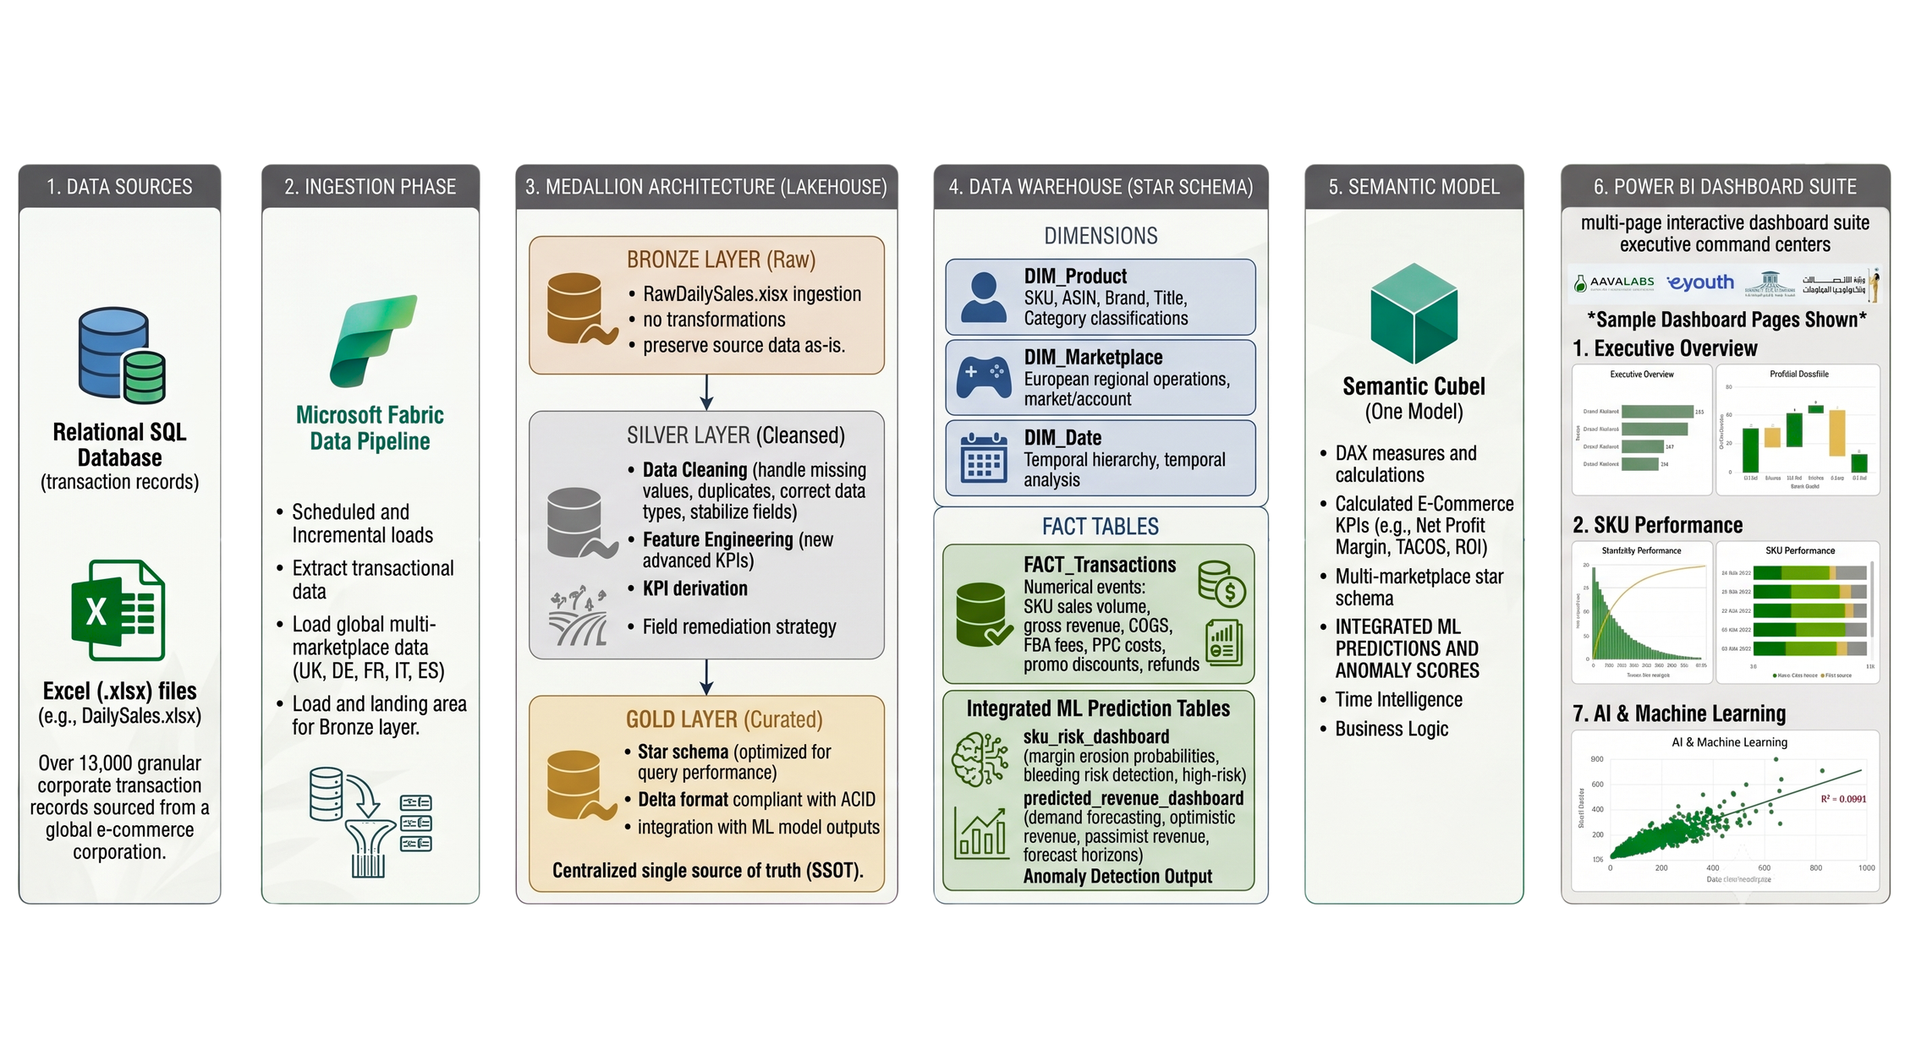
CHAPTER 2 · DATA PIPELINE
Enterprise Data Pipeline & Architecture
DEPI | Enterprise E-Commerce Intelligence
08
11/07/2026
08
Notes:
1.7.2013
8
‹#›

Slide 9



CHAPTER 2 · DATA PIPELINE
The Medallion Architecture
Raw data is never overwritten (Bronze), cleaning logic is centralized (Silver), and the analytical layer is purpose-built for Power BI (Gold).
Bronze Layer
Silver Layer
Gold Layer
Raw Ingestion
Clean & Enrich
Analytics-Ready
Raw Excel import
Data cleaning
Star schema
No transformation
Feature engineering
4 dimensions + 1 fact
Files/Bronze/
KPI derivation
Delta format
13,324 rows × 37 cols
13,324 rows x 35 cols
13,324 rows x 35 cols
DEPI | Enterprise E-Commerce Intelligence
09
11/07/2026
08
Notes:
1.7.2013
8
‹#›

Slide 10



CHAPTER 3 · DATA ENGINEERING & ANALYSIS
Cleaning Across Bronze & Silver
Bronze → Silver
Anomalies Detected & Remediated
Import raw DailySales.xlsx via Pandas
PPC_Cost
Imputed with 0.00 to reflect zero ad spend
Missing/null on organic sales
Verify records with head() & info()
Confirm shape: 13,324 rows × 37 cols
Imputed with 0.00 for full-price units
Promo_Amount
Validate schema via columns list
Unrecorded discount fields
Export clean raw_data.csv baseline
Deduplicated, earliest timestamp kept
Transaction_ID
Handle missing values & duplicates
Duplicate entry attempts
Standardize text fields & data types
Refund_Amount
Standardized to absolute positive values
Engineer new business features
Inconsistent sign entry (±)
DEPI | Enterprise E-Commerce Intelligence
10
11/07/2026
10
Notes:
1.7.2013
10
‹#›

Slide 11

Gold Layer: The Star Schema
CHAPTER 2 · DATA MODEL
One central Fact Table surrounded by dimension tables, joined via surrogate keys. All tables saved in Delta format for ACID compliance.
dim_date
dim_market_account
Date_ID · Year · Quarter · Month · Day
Market_ID · Account Title · Market Place
fact_transactions
Clicks · COGS · FBA Fees · Net Profit · Net ROI · Orders · PPC Cost · Refunded · Revenue · Sessions · Units
dim_product
ML prediction tables
SKU_ID · ASIN · Brand · FNSKU · Title
predicted_revenue · sku_risk_dashboard
DEPI | Enterprise E-Commerce Intelligence
11
11/07/2026
09
Notes:
1.7.2013
9
‹#›

Slide 12




CHAPTER 4 · MACHINE LEARNING
Isolation Forest: Detecting the Unexpected
Traditional BI explains what already happened. This AI module goes further — an unsupervised Isolation Forest model detects abnormal sales patterns, revenue fluctuations, and unusual operational behavior, enabling proactive decisions before problems escalate.
Load Gold Dataset
Preprocess & Select Features
Prepare Numerical Inputs
Train Isolation Forest
Predict Anomalies
Evaluate Results
Export for Reporting
Why Isolation Forest?
Unsupervised — no labeled training data required. It isolates records that differ from normal patterns: the easier a transaction is to isolate, the more likely it's an anomaly. Highly efficient on large datasets and excellent at surfacing rare, unexpected business events like refund spikes or conversion drops.
DEPI | Enterprise E-Commerce Intelligence
12
11/07/2026
11
Notes:
1.7.2013
11
‹#›

Slide 13












CHAPTER 4 · MODEL DETAILS
Signals the Model Watches, and What It Delivers
Selected Features
Business Value
Revenue
Orders
Units
Net Profit
Early detection of abnormal sales behavior
Flags unexpected revenue & profit swings
Net Margin
PPC Cost
PPC Sales
Refund %
Sessions
Page Views
Clicks
Impressions
Surfaces unusual product performance
Reduces manual data inspection effort
Model Output
Normal : follows expected business behavior.
Anomaly: differs significantly, flagged for review.
Speeds up investigation of operational issues
Sharper, faster, data-driven decisions
Each record also receives an Anomaly Score higher scores signal greater likelihood of unusual behavior.
DEPI | Enterprise E-Commerce Intelligence
13
11/07/2026
12
Notes:
1.7.2013
12
‹#›

Slide 14





CHAPTER 5 · DASHBOARD & VISUALIZATION
Designed First in Figma. Built to Perform in Power BI.
A design-first approach defined the full experience — layouts, navigation, color palette, and KPI placement — before a single visual was built, ensuring consistency across all seven pages.
Visual Hierarchy
Color Psychology
Dynamic Interactivity
1
Executive KPI cards up top
Alert Red — negative ROI, Bleeding SKUs, refund leakage
Instant segmentation slicers
Macro-trend charts mid-page
Date range
2
Growth Green & Deep Teal — healthy revenue & strong margins
Marketplace (UK · DE · FR · IT · ES)
3
Granular data matrices below
Soft neutrals — clean corporate readability
Product category & SKU ID
4
Fixed navigation sidebar
Synced nav sidebar every page
DEPI | Enterprise E-Commerce Intelligence
14
11/07/2026
13
Notes:
1.7.2013
13
‹#›

Slide 15
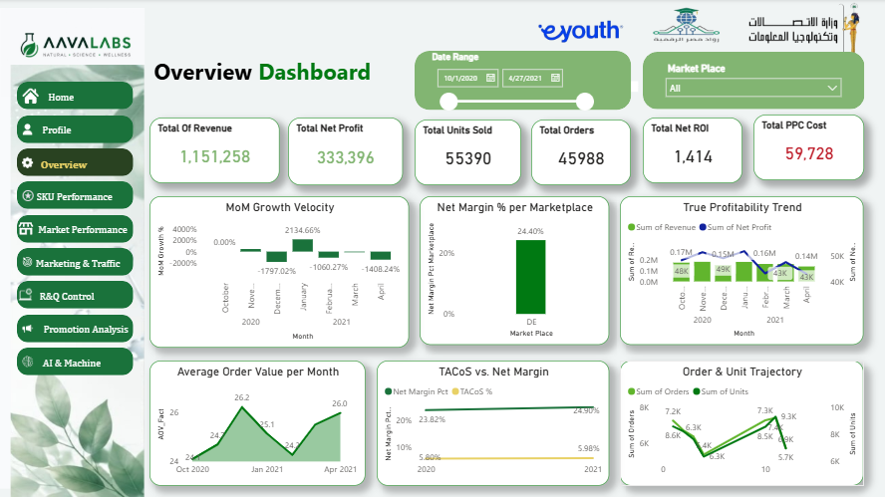


DASHBOARD 1 OF 7 · POWER BI COMMAND CENTER
Executive Overview
A high-level summary of overall business performance across all Amazon marketplaces built for decision-makers to assess revenue, profitability, and sales trends at a glance.
PRIMARY KPIs
Total Revenue
Total Net Profit
Total Units Sold
Total Orders
Net ROI
Total PPC Cost
KEY VISUALIZATIONS
INSERT DASHBOARD SCREENSHOT
Monthly Revenue Growth
Net Margin by Marketplace
Power BI · Page 1 — Executive Overview
Profitability Trend Over Time
TACoS vs Net Margin Analysis
Filters: Date · Marketplace
DEPI | Enterprise E-Commerce Intelligence
15
11/07/2026
14
Notes:
1.7.2013
14
‹#›

Slide 16
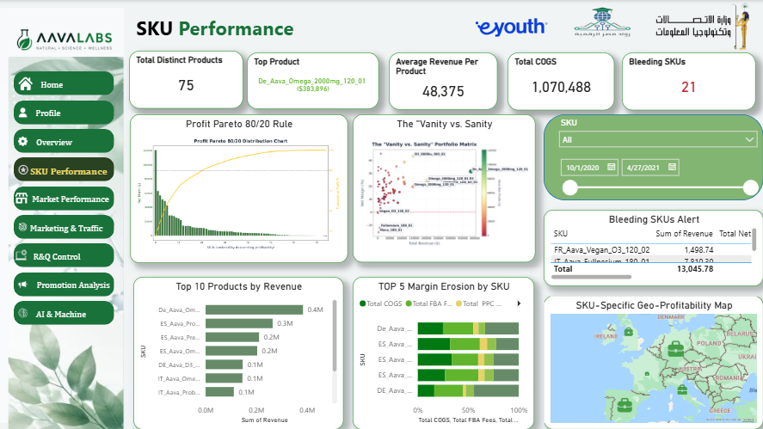
DASHBOARD 2 OF 7 · POWER BI COMMAND CENTER
SKU Performance
Product-level analysis that surfaces top performers and pinpoints underperforming SKUs that quietly erode profitability.
PRIMARY KPIs
Total Distinct Products
Highest Product Revenue
Avg Revenue / Product
Total COGS
Bleeding SKU Count
KEY VISUALIZATIONS
Top 10 Products by Revenue
Bleeding SKU Alert Table
Profit Pareto Analysis (80/20)
Geographic Profitability Map
Filters: Date · SKU
DEPI | Enterprise E-Commerce Intelligence
16
11/07/2026
15
Notes:
1.7.2013
15
‹#›

Slide 17
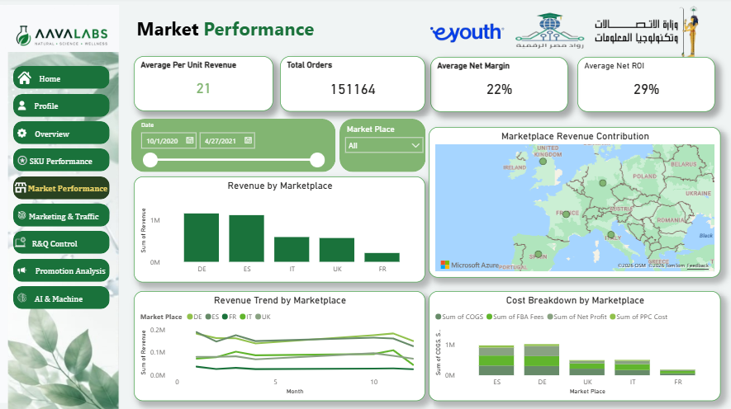
DASHBOARD 3 OF 7 · POWER BI COMMAND CENTER
Marketplace & Geographic Performance
Compares performance across UK, DE, FR, IT and ES — helping management evaluate regional sales, profitability, and operational efficiency.
PRIMARY KPIs
Revenue per Unit
Total Orders
Average Net ROI
Average Net Margin
KEY VISUALIZATIONS
Revenue by Marketplace
Geographic Revenue Map
Revenue Trend by Marketplace
Marketplace Cost Breakdown
Filters: Date · Marketplace
DEPI | Enterprise E-Commerce Intelligence
17
11/07/2026
16
Notes:
1.7.2013
16
‹#›

Slide 18
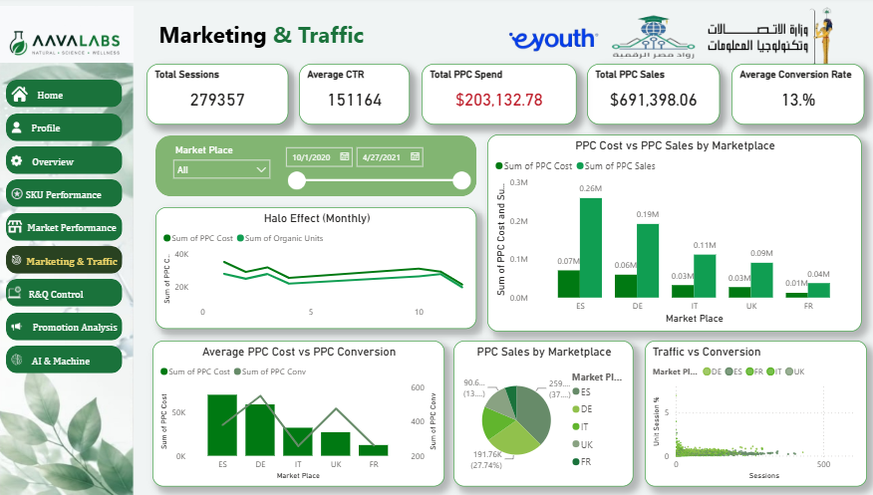
DASHBOARD 4 OF 7 · POWER BI COMMAND CENTER
Marketing, Traffic & Halo Effect
Measures advertising performance and the relationship between PPC campaigns and organic sales — quantifying the Halo Effect of paid ads.
PRIMARY KPIs
Total Sessions
Average CTR
Total PPC Spend
Total PPC Sales
Avg Conversion Rate
KEY VISUALIZATIONS
Halo Effect Trend
PPC Cost vs PPC Sales
Traffic vs Conversion Scatter
PPC Sales Distribution
Filters: Date · Marketplace
DEPI | Enterprise E-Commerce Intelligence
18
11/07/2026
17
Notes:
1.7.2013
17
‹#›

Slide 19
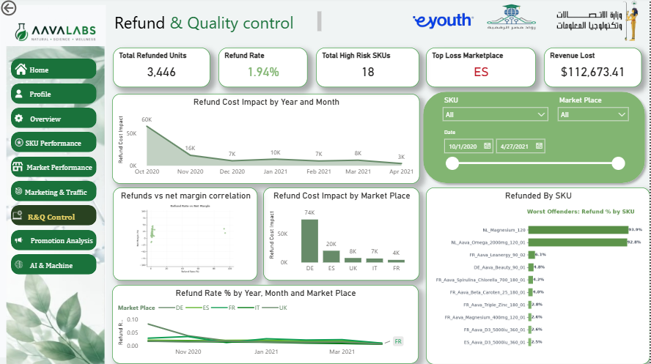
DASHBOARD 5 OF 7 · POWER BI COMMAND CENTER
Refund Leakage & Quality Control
Focuses on product quality, refund behavior, and the financial losses caused by customer returns across the business.
PRIMARY KPIs
Total Refunded Units
Refund Rate
High-Risk SKUs
Revenue Lost to Refunds
Highest Refund Market
KEY VISUALIZATIONS
Refund Cost Trend
Worst Offending SKUs
Refund Rate vs Net Margin
High-Risk Product Matrix
Filters: SKU · Marketplace
DEPI | Enterprise E-Commerce Intelligence
19
11/07/2026
18
Notes:
1.7.2013
18
‹#›

Slide 20
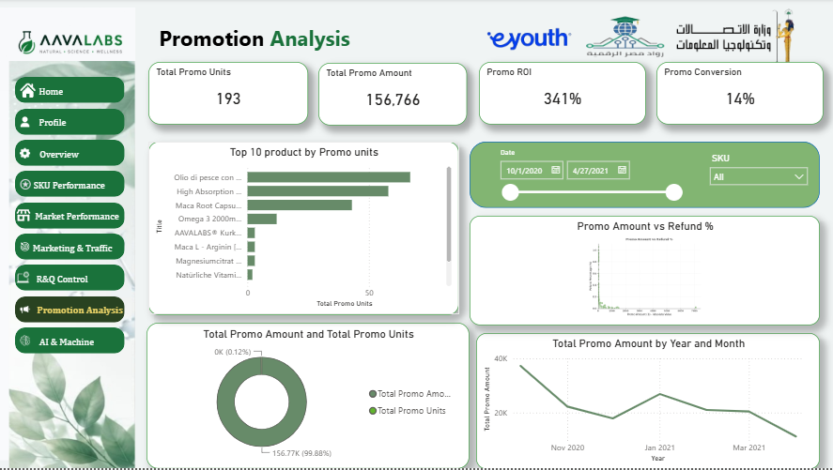
DASHBOARD 6 OF 7 · POWER BI COMMAND CENTER
Promotions Analysis
Evaluates promotional campaign effectiveness by comparing promo sales against organic sales while tracking financial impact.
PRIMARY KPIs
Total Promo Units
Total Promo Amount
Promo ROI
Promo Conversion Rate
KEY VISUALIZATIONS
Organic vs Promotional Units
Promo Amount Trend
Top Products by Promo Units
Promo Amount vs Refund Rate
Filters: Date · SKU
DEPI | Enterprise E-Commerce Intelligence
20
11/07/2026
19
Notes:
1.7.2013
19
‹#›

Slide 21
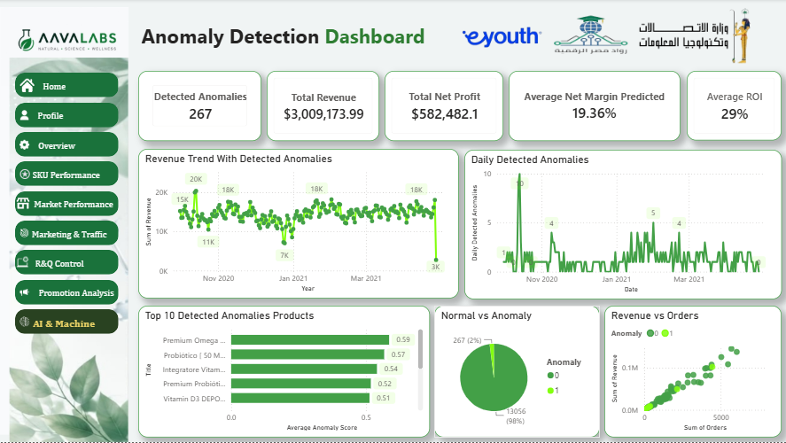
DASHBOARD 7 OF 7 · POWER BI COMMAND CENTER
AI & Machine Learning
Surfaces predictive analytics results — Isolation Forest anomaly detection, revealing unusual behaviors before they hit the bottom line.
PRIMARY KPIs
Detected Anomalies
Total Revenue
Avg Predicted Net Margin
Total Net Profit
Average ROI
KEY VISUALIZATIONS
Revenue Trend with Detected Anomalies
Daily Detected Anomalies
Top 10 Anomalous Products
Normal vs. Anomaly Distribution
Filters: Date · Marketplace
DEPI | Enterprise E-Commerce Intelligence
21
11/07/2026
20
Notes:
1.7.2013
20
‹#›

Slide 22
11/07/2026
Notes:
1.7.2013
20
‹#›

Slide 23
CHAPTER 5 · DESIGN SUMMARY
From 13,000 Rows to Real Commercial Value
The suite transforms raw corporate records into an executive intelligence system — pairing a clean Medallion data architecture with Prophet & Random Forest predictive outputs.
Data Engineering
Reconciled 13,000+ records into a clean star schema.
Eliminates data silos — establishes 100% data trust across teams.
Machine Learning
60-day demand forecasts + Bleeding SKU risk probabilities.
Prevents stockouts and proactively protects gross product margins.
BI Visualization
7 interactive Power BI command centers.
Empowers executives to optimize PPC budgets, cut waste, drive growth.
DEPI | Enterprise E-Commerce Intelligence
22
11/07/2026
21
Notes:
1.7.2013
21
‹#›

Slide 24
Thank You
Questions & Discussion
Duaa Abd-Elati · Hazem Mahmoud · Mai Gamal Maya Mohamed · Osama Hussein · Ahmed Ezzat
Digital Egypt Pioneers Initiative — Data Analysis Track
2025/2026
Notes:
1.7.2013
22
‹#›

